Slide 1
Participant ID_P25
Gogi. Aishwarya

Slide 2
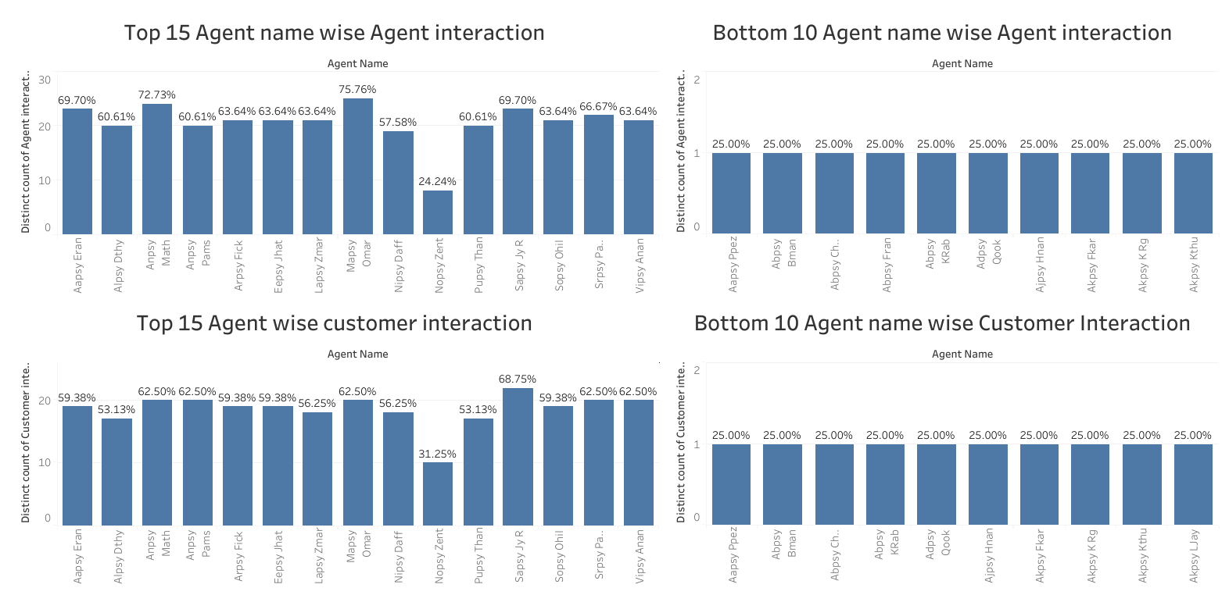

Slide 3
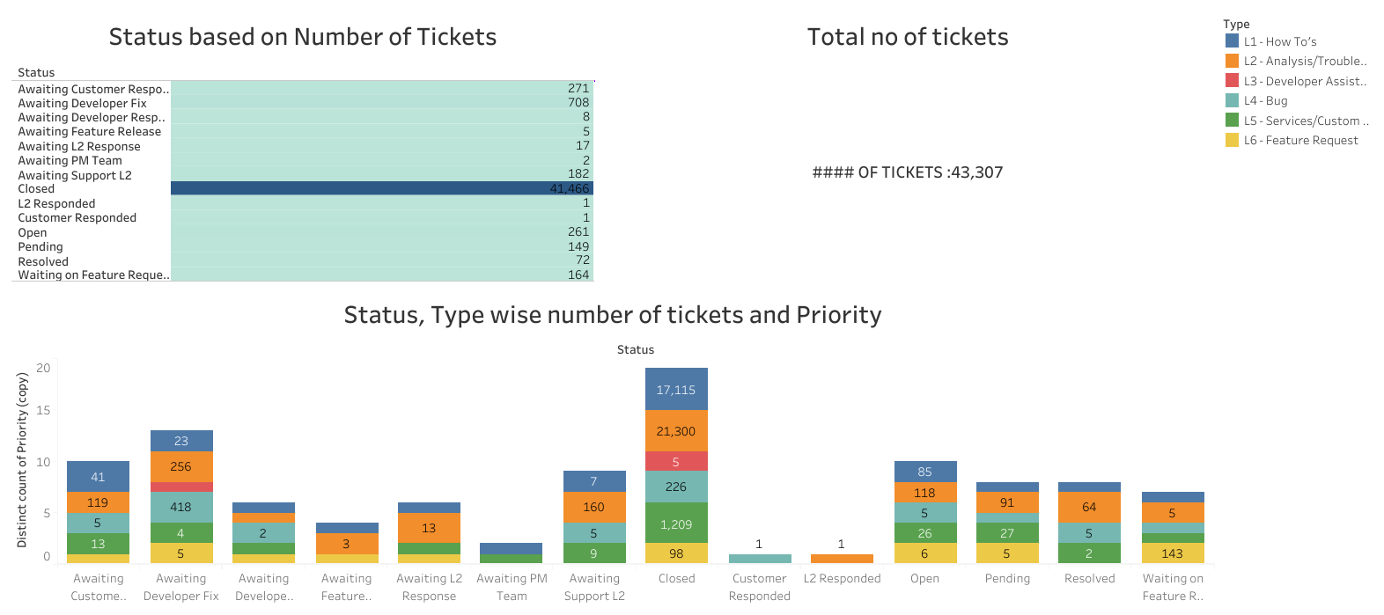

Slide 4
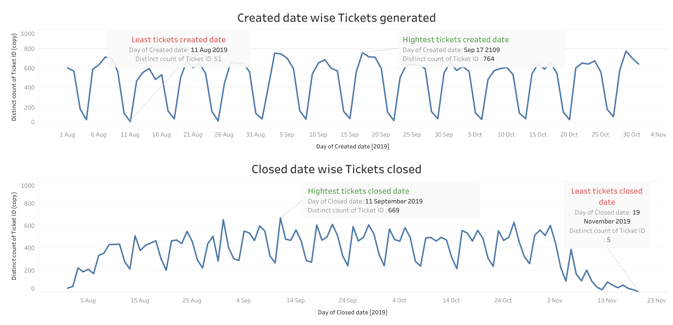

Slide 5
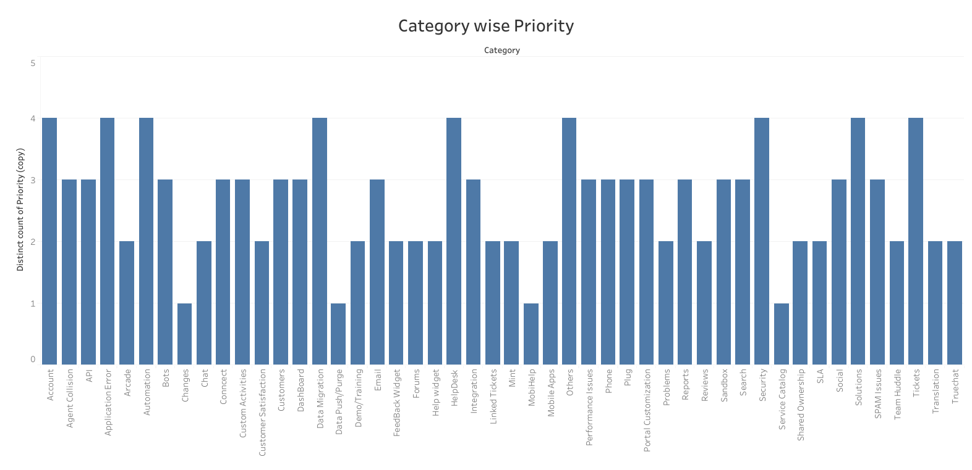

Slide 6
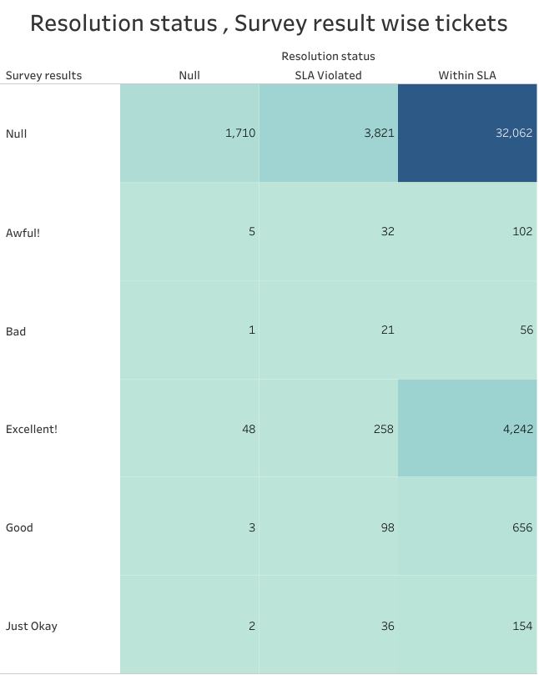

Slide 7
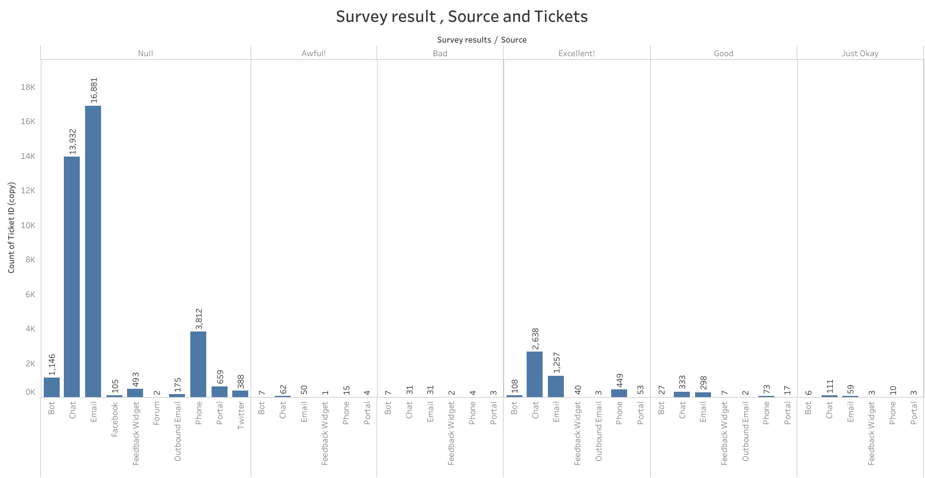

Slide 8
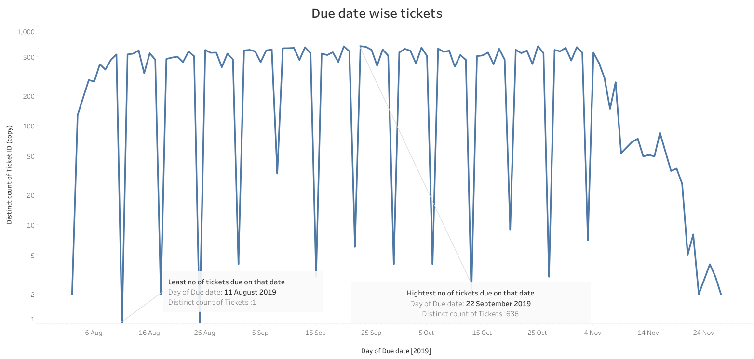

Slide 9
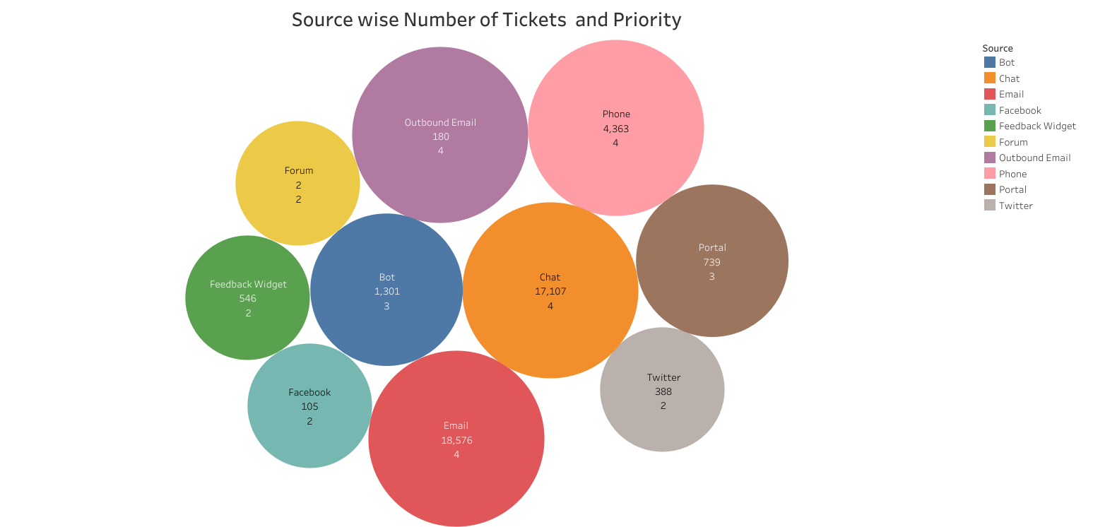

Slide 10
Recommendations to improve the customer satisfaction
Agent need to resolve the priority tickets before SLA.
Need to focus on the all the sources for which tickets are raised.
Survey results from the customer need to taken under consideration and work on it.
To get the good survey result the tickets need to be resolved with in the time provided.
As the tickets are not been resolved on time highest survey results is Null.
Organization should find where the agents are lacking behind and also the train the
bottom performers to push them self to get good satisfaction result from customers.

Slide 11
Thank you

